Slide 1
Contact Manager App
fljdsf

Slide 2
Members we are group 15
Yuri Rubio
Peter Castro
Amanda Gilliam
Christian Jaimes
Sergio Perez
Eóin Reilly

Slide 3
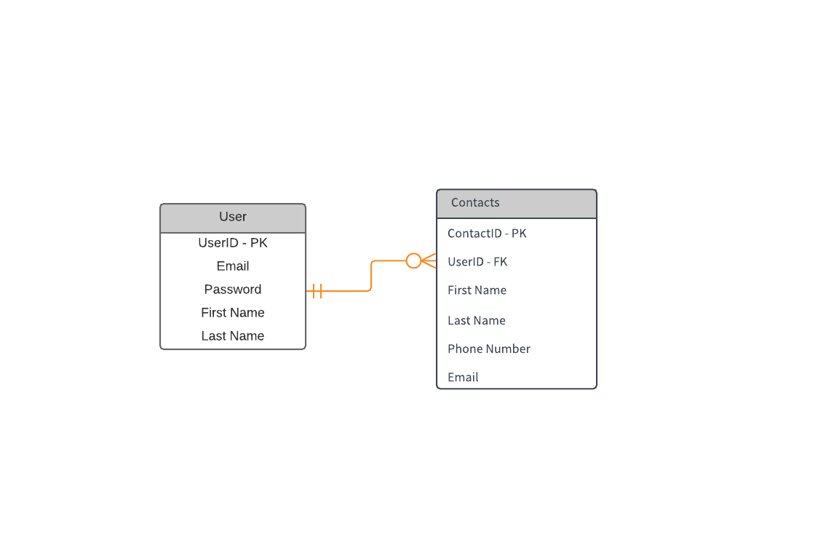
ERD

Slide 4
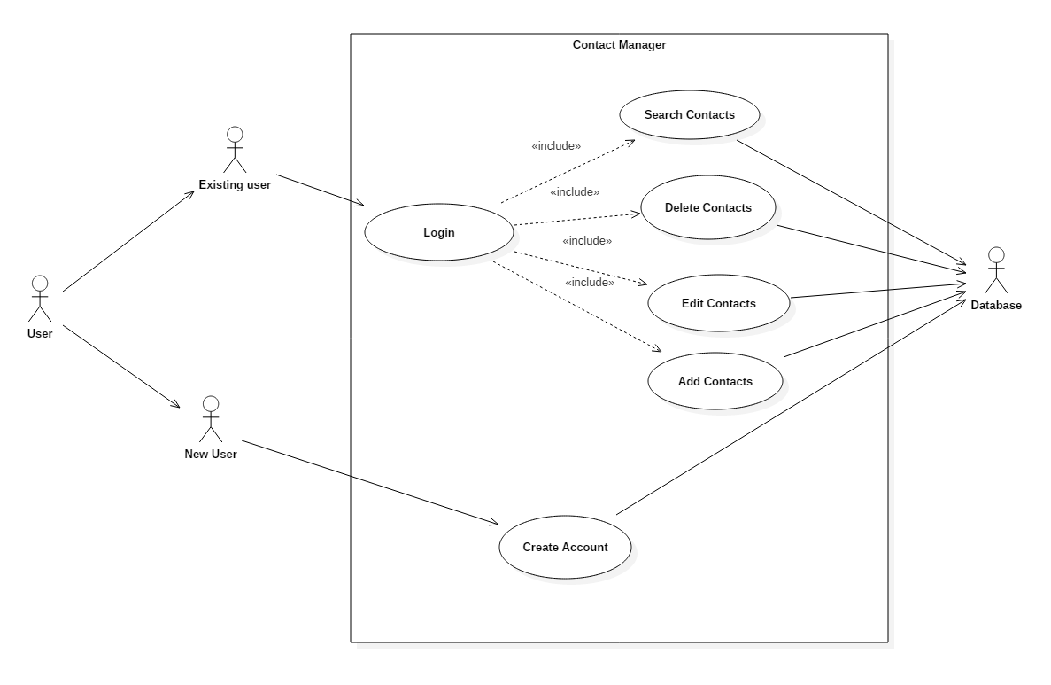
Uml: Use case diagram

Slide 5
Backend
MERN Stack
Mongo DB, Express, REACT, Node.js
Dependencies:
Mongoose – Creating User & Contact schema, and communicating with MongoDB
Express – creates endpoints
Express-Session – let’s the server know there’s a user logged in
CORS – connected backend to frontend
BCRYPT – hashes information
Hosted by:
Google Cloud Platform
Running Ubuntu 16.04LTS

Slide 6
Frontend
Done with REACT, which uses JSX and SPA procedure
JS version 6
REACT offers an option to make mobile applications using the same code we wrote here; renders components without refreshing the web page
Dependencies:
Bootstrap – for styling
AXIOS – handles our http connections
BCRYPT – hashes information
Babel – takes REACT code and allows it to run on older browsers

Slide 7
Challenges
The communication between the backend and the frontend
A major issue with the session
Styling the web application
Problems with GitHub

Slide 8
Demo
http://35.227.40.134/

Slide 9
Questions?
We are Group 15

